Slide 1


Noida Institute of Engineering and Technology, Greater Noida
Design Pattern
Unit: IV
Introduction to Design Pattern
Ibrar Ahmed
(Asst. Professor)
CSE Department
Course Details (B. Tech. 5th Sem)

Slide 2

Faculty Introduction
Name | Ibrar Ahmed
Qualification | M. Tech. (Computer Engineering)
Designation | Assistant Professor
Department | Computer Science & Engineering
Total Experience | 4 years
NIET Experience | 1 years
Subject Taught | Design & Analysis of Algorithm, Data Structures, Artificial Intelligence, Soft Computing, C Programming, Web Technology, Discrete Mathematics.

Slide 3
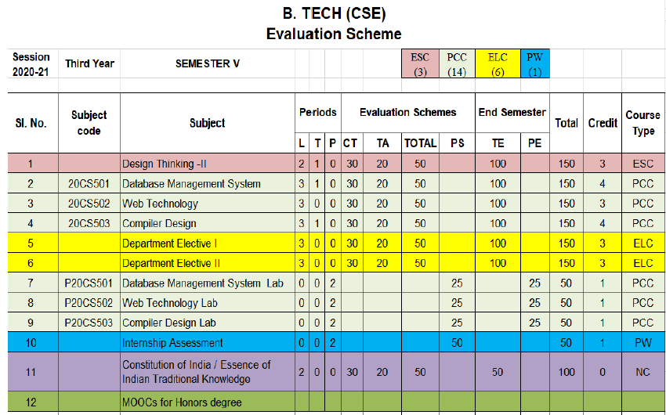
Evaluation Scheme
Python Web development with Django
Design Pattern

Slide 4
Syllabus
UNIT-I: Introduction of Design Pattern
Describing Design Patterns, Design Patterns in Smalltalk MVC, The Catalogue of Design Patterns, Organizing The Cato log, How Design Patterns solve, Design Problems, How to Select a Design pattern, How to Use a Design Pattern. Principle of least knowledge.

Slide 5
Syllabus
UNIT-II: Creational Design Pattern
A Case Study: Designing a Document Editor
Creational Patterns: Abstract Factory, Builder , Factory Method, Prototype , Singleton Pattern,

Slide 6
Syllabus
UNIT-III: Structural Design Pattern
Structural Pattern Part-I, Adapter, Bridge, Composite.
Structural Pattern Part-II, Decorator, Facade, Flyweight, Proxy.

Slide 7
Syllabus
UNIT-IV: Behavioral Design Patterns Part: I
Behavioral Patterns Part: I, Chain of Responsibility, Command, Interpreter, Iterator Pattern.
Behavioral Patterns Part: II, Mediator, Memento, Observer, Patterns.

Slide 8
Syllabus
UNIT-V: Behavioral Design Patterns Part: II
Behavioral Patterns Part: III, State, Strategy, Template Method, Visitor, What to Expect from Design Patterns.

Slide 9
Branch Wise Application
1. Real time web analytics
2. Digital Advertising
3. E-Commerce
4. Publishing
5. Massively Multiplayer Online Games
6. Backend Services and Messaging
7. Project Management & Collaboration
8. Real time Monitoring Services
9.Live Charting and Graphing
10. Group and Private Chat

Slide 10
Course Objective
In this semester, the students will
Study how to shows relationships and interactions between classes or objects..
Study to speed up the development process by providing well-tested, proven development/design paradigms.
Select a specific design pattern for the solution of a given design problem.
Create a catalogue entry for a simple design pattern whose purpose and application is understood.

Slide 11
Course Outcomes (COs)
At the end of course, the student will be able to:
CO1 : Construct a design consisting of collection of modules.
CO2 : Exploit well known design pattern such as Factory, visitor etc.
CO3 : Distinguish between different categories of design patterns.
CO4 : Ability to common design pattern for incremental development.
CO5 : Identify appropriate design pattern for a given problem and design the software using pattern oriented architecture.

Slide 12
Program Outcomes (POs)
Engineering Graduates will be able to:
PO1 : Engineering Knowledge
PO2 : Problem Analysis
PO3 : Design/Development of solutions
PO4 : Conduct Investigations of complex problems
PO5 : Modern tool usage
PO6 : The engineer and society

Slide 13
Program Outcomes (POs)
Engineering Graduates will be able to:
PO7 : Environment and sustainability
PO8 : Ethics
PO9 : Individual and teamwork
PO10 : Communication
PO11 : Project management and finance
PO12 : Life-long learning

Slide 14

COs - POs Mapping
CO.K | PO1 | PO2 | PO3 | PO4 | PO5 | PO6 | PO7 | PO8 | PO9 | PO10 | PO11 | PO12
CO1 | 2 | 2 | 2 | 3 | 3 | - | - | - | - | - | - | -
CO2 | 3 | 2 | 3 | 2 | 3 | - | - | - | - | - | - | -
CO3 | 3 | 2 | 3 | 2 | 3 | - | - | - | - | - | - | -
CO4 | 3 | 2 | 3 | 2 | 3 | - | - | - | - | - | - | -
CO5 | 3 | 2 | 3 | 3 | 3 | - | - | - | - | - | - | -
AVG | 2.8 | 2.0 | 2.8 | 2.4 | 3.0 | - | - | - | - | - | - | -

Slide 15
Program Specific Outcomes(PSOs)
S. No. | Program Specific Outcomes (PSO) | PSO Description
1 | PSO1 | Understand to shows relationships and interactions between classes or objects of a pattern.
2 | PSO2 | Study to speed up the development process by providing well-tested, proven development
3 | PSO3 | Select a specific design pattern for the solution of a given design problem
4 | PSO4 | Create a catalogue entry for a simple design pattern whose purpose and application is understood.

Slide 16
COs - PSOs Mapping
CO.K | PSO1 | PSO2 | PSO3 | PSO4
CO1 | 3 | - | - | -
CO2 | 3 | 3 | - | -
CO3 | 3 | 3 | - | -
CO4 | 3 | 3 | - | -
CO5 | 3 | 3 | - | -

Slide 17
Program Educational Objectives (PEOs)
Program Educational Objectives (PEOs) | PEOs Description
PEOs | To have an excellent scientific and engineering breadth so as to comprehend, analyze, design and provide sustainable solutions for real-life problems using state-of-the-art technologies.
PEOs | To have a successful career in industries, to pursue higher studies or to support entrepreneurial endeavors and to face the global challenges.
PEOs | To have an effective communication skills, professional attitude, ethical values and a desire to learn specific knowledge in emerging trends, technologies for research, innovation and product development and contribution to society.
PEOs | To have life-long learning for up-skilling and re-skilling for successful professional career as engineer, scientist, entrepreneur and bureaucrat for betterment of society.

Slide 18
Result Analysis(Department Result & Subject Result & Individual result
Name of the faculty | Subject code | Result % of clear passed
Mr. Sanjay Nayak

Slide 19
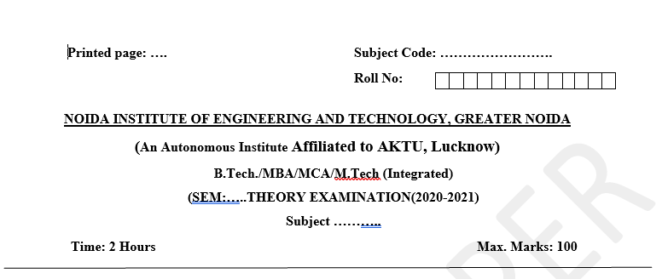
Pattern of Online External Exam Question Paper (100 marks)

Slide 20
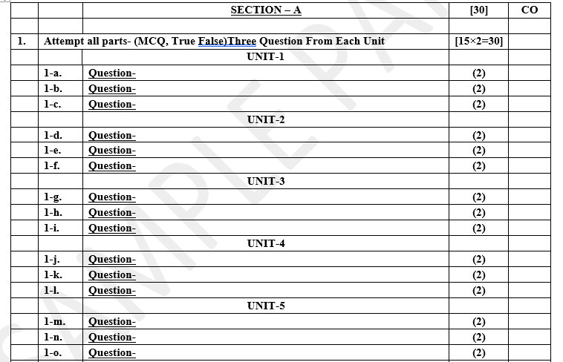
Pattern of Online External Exam Question Paper (100 marks)

Slide 21
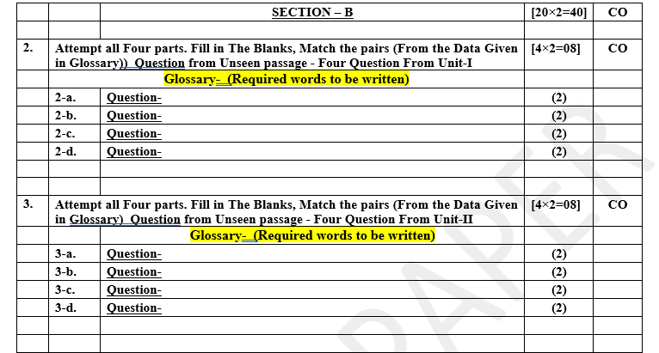
Pattern of Online External Exam Question Paper (100 marks)

Slide 22
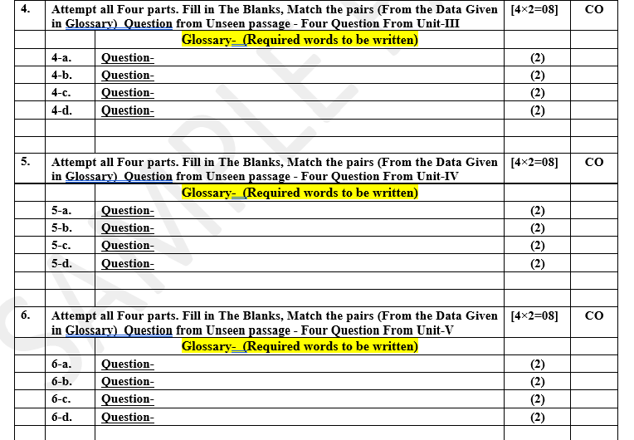
Pattern of Online External Exam Question Paper (100 marks)

Slide 23
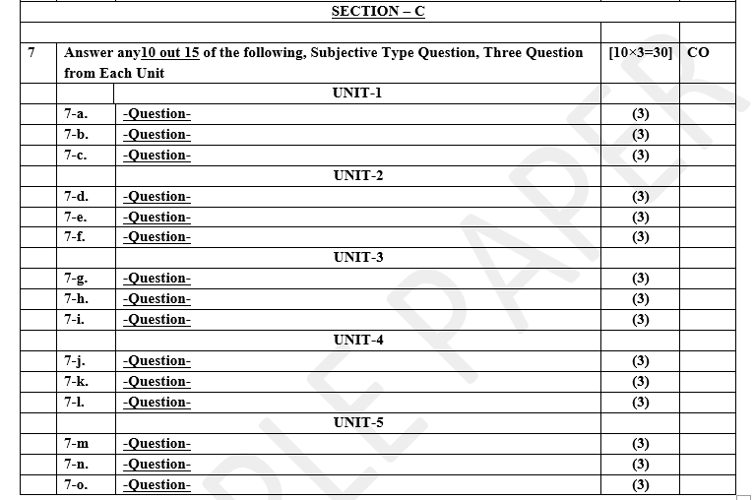
Pattern of Online External Exam Question Paper (100 marks)

Slide 24
Prerequisite / Recap
Student should have knowledge of object oriented analysis and design.
Knowledge of Data structure and algorithm.
knowledge of Programing language such as C/C++ etc.
Good problem solving Skill .

Slide 25
Brief Introduction about the Subject with videos
YouTube /other Video Links
https://youtu.be/rI4kdGLaUiQ?list=PL6n9fhu94yhUbctIoxoVTrklN3LMwTCmd
https://youtu.be/v9ejT8FO-7I?list=PLrhzvIcii6GNjpARdnO4ueTUAVR9eMBpc
https://youtu.be/VGLjQuEQgkI?list=PLt4nG7RVVk1h9lxOYSOGI9pcP3I5oblbx

Slide 26
Unit IV Content
Behavioral Design Patterns Part-I :
Chain Of Responsibility Pattern.
Command Pattern.
Interpreter Pattern.
Iterator Pattern.
Behavioral Design Patterns Part-II :
Mediator Pattern.
Memento Pattern.
Observer Pattern.

Slide 27
Unit IV Objective
In Unit IV, the students will be able to find
Definitions of terms and concepts.
The idea of a pattern.
The origins of all design patterns.
How Patterns Work in software design.
Scope of development activity: applications, toolkits, frameworks.
All Behavioral Pattern and their need.

Slide 28
Topic Objective
Topic : Behavioral Pattern, Chain Of Responsibility.
In this topic, the students will gain , The idea of a Behavioral design pattern, In these design patterns, the interaction between the objects should be in such a way that they can easily talk to each other and still should be loosely coupled.

Slide 29
Behavioral Design Patterns
Behavioral Design Pattern:-
Behavioral design patterns are concerned with the interaction and responsibility of objects.
In these design patterns, the interaction between the objects should be in such a way that they can easily talk to each other and still should be loosely coupled.
That means the implementation and the client should be loosely coupled in order to avoid hard coding and dependencies.

Slide 30
Behavioral Design Patterns
There are 10 types of behavioral design patterns:-
Chain of Responsibility Pattern
Command Pattern
Interpreter Pattern
Iterator Pattern
Mediator Pattern
Memento Pattern
Observer Pattern
State Pattern
Strategy Pattern
Template Pattern

Slide 31
Chain Of Responsibility Pattern
Chain Of Responsibility Pattern:-
A Chain of Responsibility Pattern says that just "avoid coupling the sender of a request to its receiver by giving multiple objects a chance to handle the request". For example, an ATM uses the Chain of Responsibility design pattern in money giving process.
In chain of responsibility, sender sends a request to a chain of objects. The request can be handled by any object in the chain.
In other words, we can say that normally each receiver contains reference of another receiver. If one object cannot handle the request then it passes the same to the next receiver and so on.

Slide 32
Implementation of (Chain Of Responsibility Pattern)
We have created an abstract class AbstractLogger with a level of logging. Then we have created three types of loggers extending the AbstractLogger. Each logger checks the level of message to its level and print accordingly otherwise does not print and pass the message to its next logger.
As the name suggests, the chain of responsibility pattern creates a chain of receiver objects for a request. This pattern decouples sender and receiver of a request based on type of request. This pattern comes under behavioral patterns.
In this pattern, normally each receiver contains reference to another receiver. If one object cannot handle the request then it passes the same to the next receiver and so on.

Slide 33
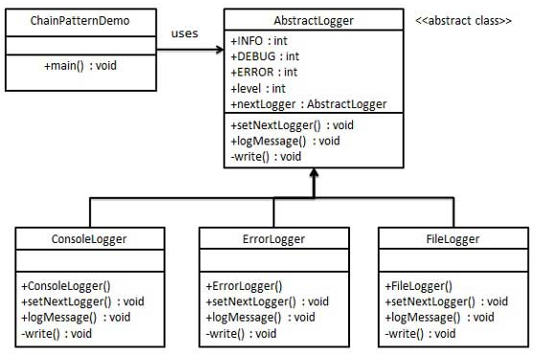
UML\Structure for Chain Of Responsibility

Slide 34
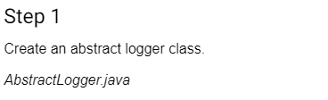
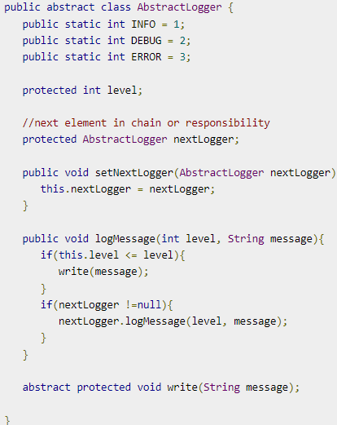
Implementation of (Chain Of Responsibility Pattern)

Slide 35
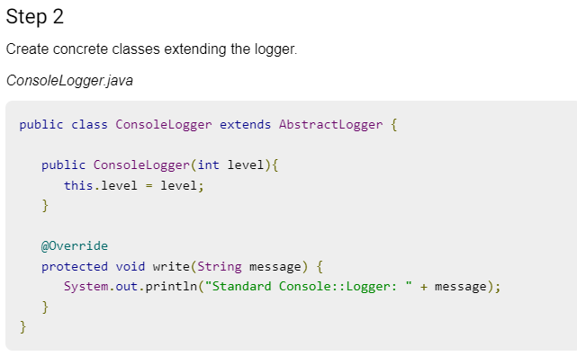
Implementation of (Chain Of Responsibility Pattern)

Slide 36
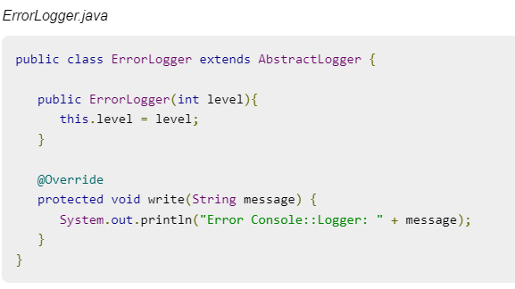
Implementation of (Chain Of Responsibility Pattern)
Step -2 Cont.……..

Slide 37
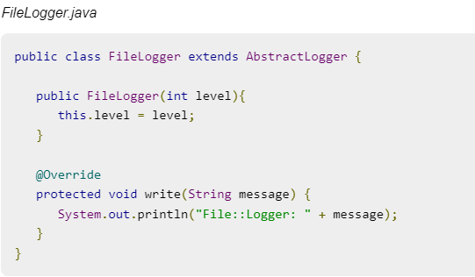
Implementation of (Chain Of Responsibility Pattern)
Step -2 Cont.……..

Slide 38
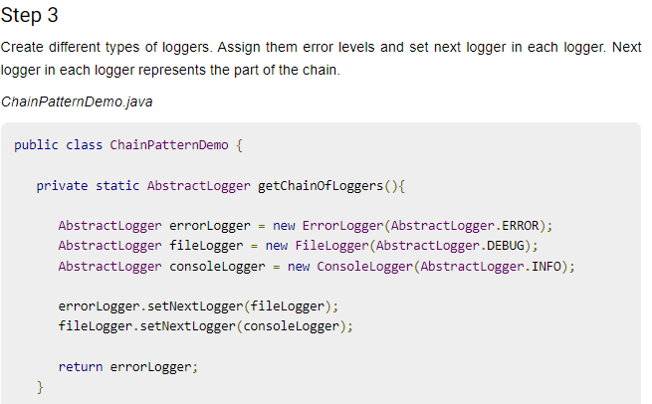
Implementation of (Chain Of Responsibility Pattern)

Slide 39
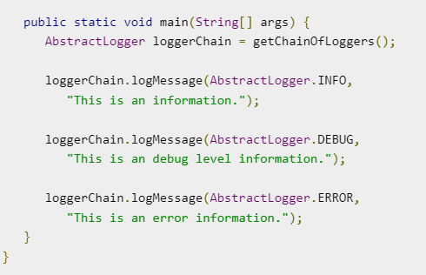
Implementation of (Chain Of Responsibility Pattern)
Step -3 Cont.……..

Slide 40
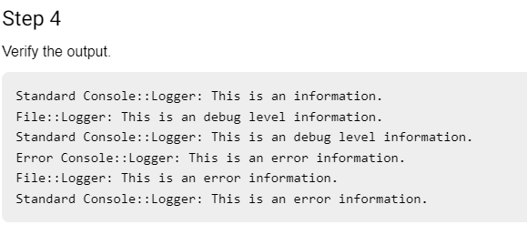
Implementation of (Chain Of Responsibility Pattern)

Slide 41
Topic Objective
Topic : Command Pattern
In this topic, the students will gain , The idea of a Command pattern is a data driven design pattern and falls under behavioral pattern category. A request is wrapped under an object as command and passed to invoker object. Invoker object looks for the appropriate object which can handle this command and passes the command to the corresponding object which executes the command.

Slide 42
Command Pattern
Command Pattern:-
A Command Pattern says that "encapsulate a request under an object as a command and pass it to invoker object. Invoker object looks for the appropriate object which can handle this command and pass the command to the corresponding object and that object executes the command".
It is also known as Action or Transaction.
It separates the object that invokes the operation from the object that actually performs the operation.
It makes easy to add new commands, because existing classes remain unchanged.

Slide 43
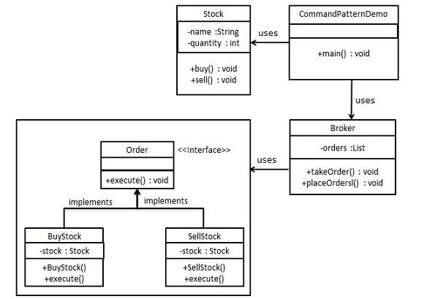
UML\Structure for Command Pattern

Slide 44
Implementation of (Command Pattern)
We have created an interface Order which is acting as a command. We have created a Stock class which acts as a request. We have concrete command classes BuyStock and SellStock implementing Order interface which will do actual command processing. A class Broker is created which acts as an invoker object. It can take and place orders.
Broker object uses command pattern to identify which object will execute which command based on the type of command. CommandPatternDemo, our demo class, will use Broker class to demonstrate command pattern.
Command pattern is a data driven design pattern and falls under behavioral pattern category. A request is wrapped under an object as command and passed to invoker object.

Slide 45
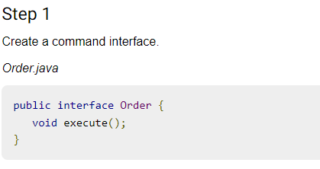
Implementation of (Command Pattern)

Slide 46
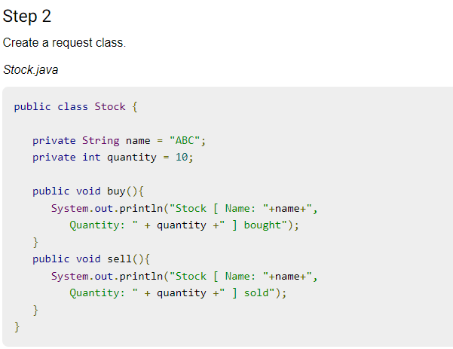
Implementation of (Command Pattern)

Slide 47
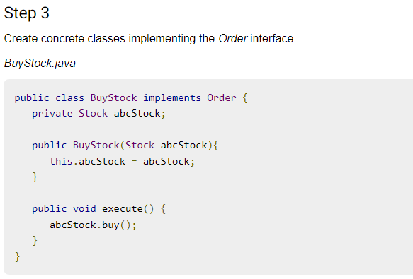
Implementation of (Command Pattern)

Slide 48
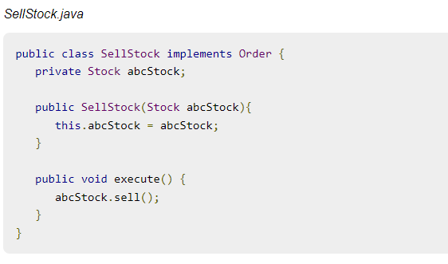
Implementation of (Command Pattern)
Step -3 Cont.……..

Slide 49
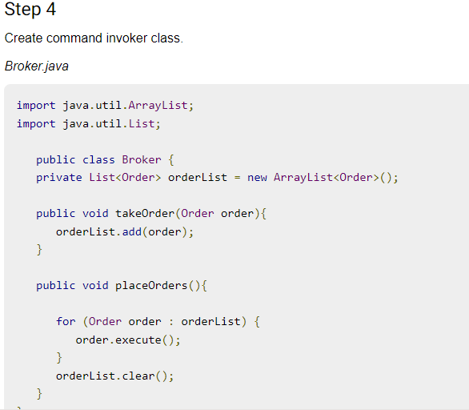
Implementation of (Command Pattern)

Slide 50
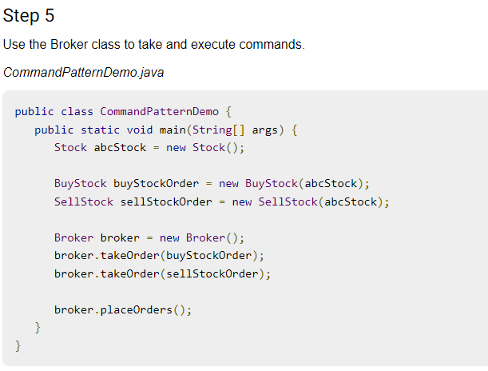
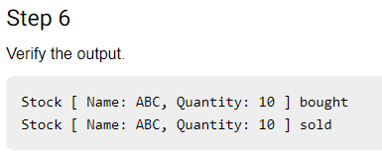
Implementation of (Command Pattern)

Slide 51
Topic Objective
Topic : Interpreter Pattern
In this topic, the students will gain , The idea of a Interpreter Pattern An Interpreter Pattern says that "to define a representation of grammar of a given language, along with an interpreter that uses this representation to interpret sentences in the language".

Slide 52
Interpreter Pattern
Interpreter Pattern:-
An Interpreter Pattern says that "to define a representation of grammar of a given language, along with an interpreter that uses this representation to interpret sentences in the language".
Basically the Interpreter pattern has limited area where it can be applied. We can discuss the Interpreter pattern only in terms of formal grammars but in this area there are better solutions that is why it is not frequently used.
This pattern can applied for parsing the expressions defined in simple grammars and sometimes in simple rule engines.

Slide 53
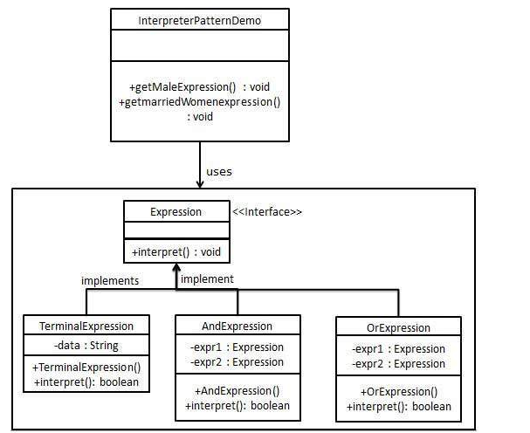
UML\Structure for Interpreter Pattern

Slide 54
Implementation of (Interpreter Pattern)
We are going to create an interface Expression and concrete classes implementing the Expression interface. A class TerminalExpression is defined which acts as a main interpreter of context in question. Other classes OrExpression, AndExpression are used to create combinational expressions.
InterpreterPatternDemo, our demo class, will use Expression class to create rules and demonstrate parsing of expressions.
Interpreter pattern provides a way to evaluate language grammar or expression. This type of pattern comes under behavioral pattern. This pattern involves implementing an expression interface which tells to interpret a particular context.

Slide 55
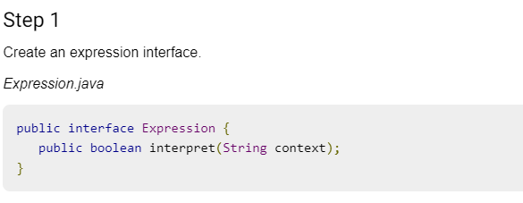
Implementation of (Interpreter Pattern)

Slide 56
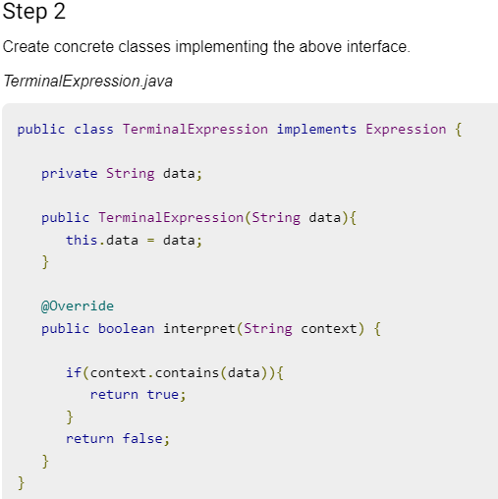
Implementation of (Interpreter Pattern)

Slide 57
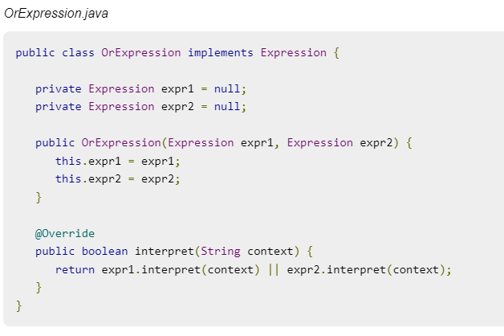
Implementation of (Interpreter Pattern)
Step -2 Cont.……..

Slide 58
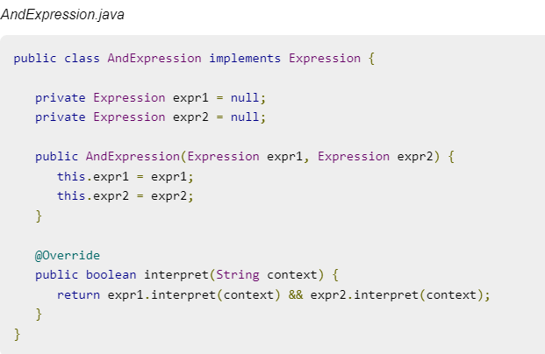
Implementation of (Interpreter Pattern)
Step -2 Cont.……..

Slide 59
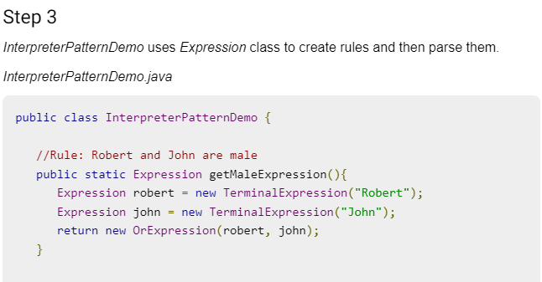
Implementation of (Interpreter Pattern)

Slide 60
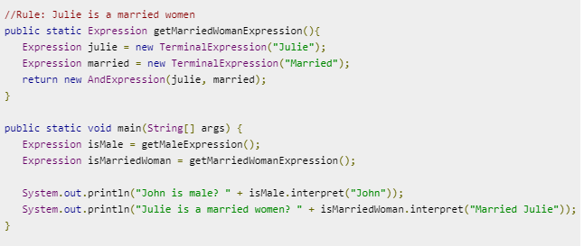
Implementation of (Interpreter Pattern)
Step -3 Cont.……..

Slide 61
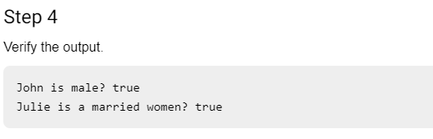
Implementation of (Interpreter Pattern)

Slide 62
Topic Objective
Topic : Iterator Pattern
In this topic, the students will gain , The idea an Iterator PatternAccording to GoF, Iterator Pattern is used "to access the elements of an aggregate object sequentially without exposing its underlying implementation".The Iterator pattern is also known as Cursor.In collection framework, we are now using Iterator that is preferred over Enumeration.

Slide 63
Iterator Pattern
Iterator Pattern:-
Iterator pattern is very commonly used design pattern in Java and .Net programming environment. This pattern is used to get a way to access the elements of a collection object in sequential manner without any need to know its underlying representation.
Iterator pattern falls under behavioral pattern category.
It supports variations in the traversal of a collection. It simplifies the interface to the collection.
It is used When you want to access a collection of objects without exposing its internal representation.

Slide 64
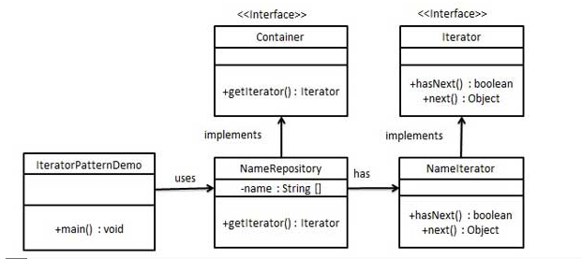
UML\Structure for Iterator Pattern

Slide 65
Implementation of (Iterator Pattern)
We're going to create a Iterator interface which narrates navigation method and a Container interface which retruns the iterator . Concrete classes implementing the Container interface will be responsible to implement Iterator interface and use it
IteratorPatternDemo, our demo class will use NamesRepository, a concrete class implementation to print a Names stored as a collection in NamesRepository.
It is used When there are multiple traversals of objects need to be supported in the collection.

Slide 66
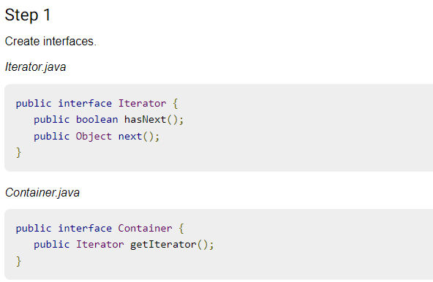
Implementation of (Iterator Pattern)

Slide 67
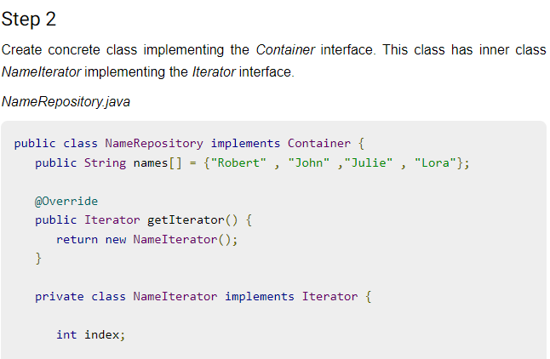
Implementation of (Iterator Pattern)

Slide 68
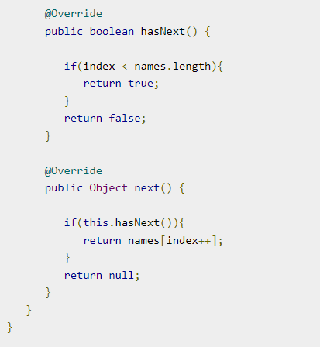
Implementation of (Iterator Pattern)
Step -2 Cont.……..

Slide 69
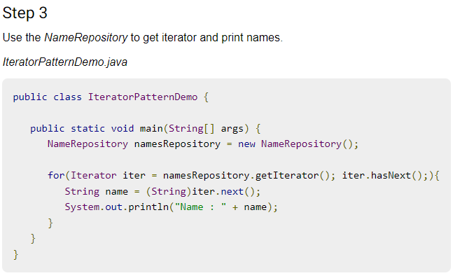
Implementation of (Iterator Pattern)

Slide 70
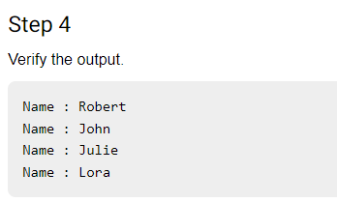
Implementation of (Iterator Pattern)

Slide 71
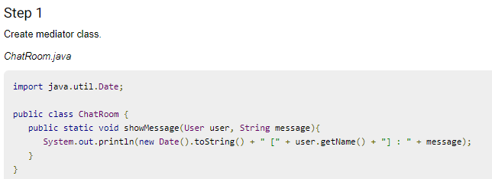
Implementation of (Mediator Pattern)

Slide 72
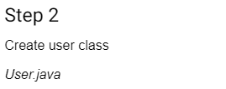
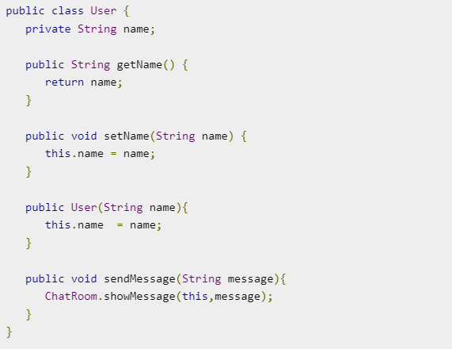
Implementation of (Mediator Pattern)

Slide 73
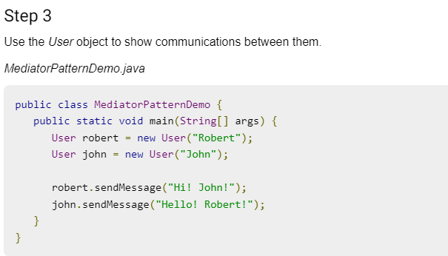
Implementation of (Mediator Pattern)

Slide 74
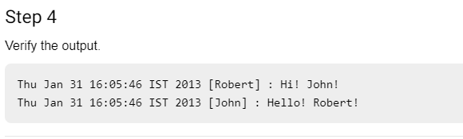
Implementation of (Mediator Pattern)

Slide 75
Topic Objective
Topic : Memento Pattern
In this topic, the students will gain , The idea an Memento Pattern i.e Memento pattern is used to restore state of an object to a previous state. Memento pattern falls under behavioral pattern category.

Slide 76
Memento Pattern
Memento Pattern:-
A Memento Pattern says that "to restore the state of an object to its previous state". But it must do this without violating Encapsulation. Such case is useful in case of error or failure.The Memento pattern is also known as Token.
Undo or backspace or ctrl+z is one of the most used operation in an editor. Memento design pattern is used to implement the undo operation. This is done by saving the current state of the object as it changes state.
It preserves encapsulation boundaries. It simplifies the originator.

Slide 77
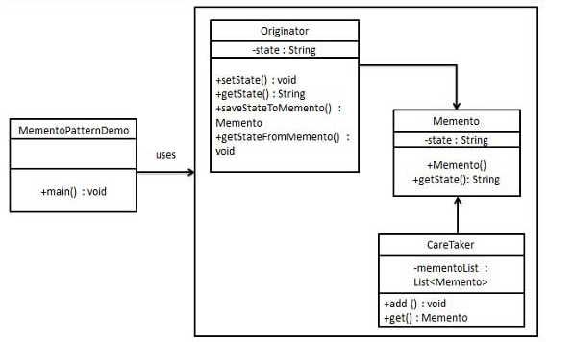
UML\Structure for Memento Pattern

Slide 78
Implementation of (Memento Pattern)
Memento pattern uses three actor classes. Memento contains state of an object to be restored. Originator creates and stores states in Memento objects and Caretaker object is responsible to restore object state from Memento. We have created classes Memento, Originator and CareTaker.
MementoPatternDemo, our demo class, will use CareTaker and Originator objects to show restoration of object states.
It is used in Undo and Redo operations in most software.
It is also used in database transactions.

Slide 79
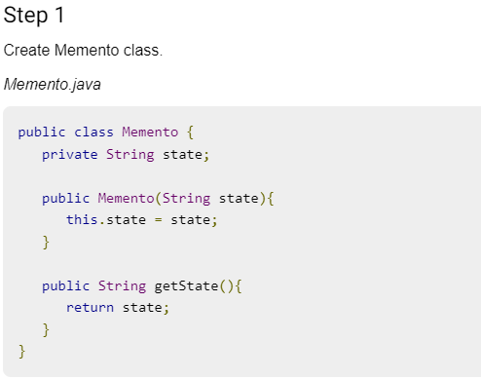
Implementation of (Memento Pattern)

Slide 80
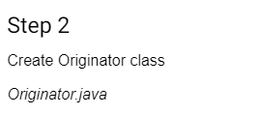
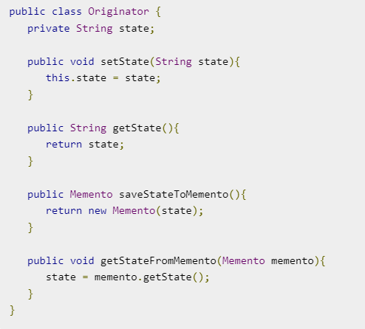
Implementation of (Memento Pattern)

Slide 81
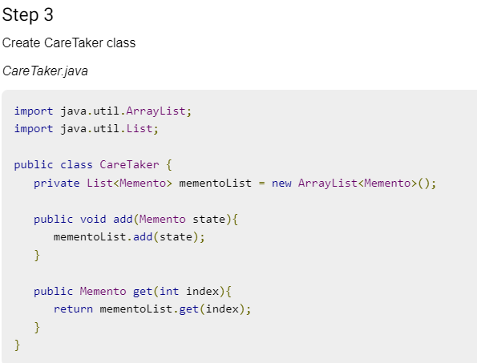
Implementation of (Memento Pattern)

Slide 82
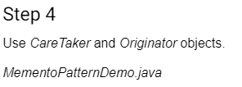
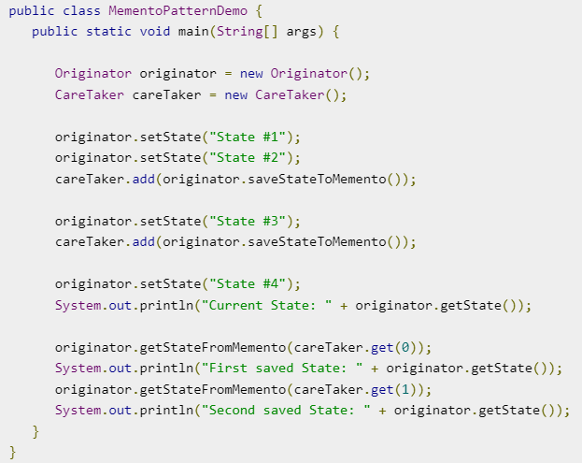
Implementation of (Memento Pattern)

Slide 83
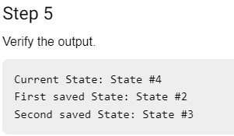
Implementation of (Memento Pattern)

Slide 84
Topic Objective
Topic : Observer Pattern
In this topic, the students will gain , The idea an Observer Pattern i.e An Observer Pattern says that "just define a one-to-one dependency so that when one object changes state, all its dependents are notified and updated automatically".

Slide 85
Observer Pattern
Observer Pattern:-
Observer pattern is used when there is one-to-many relationship between objects such as if one object is modified, its depenedent objects are to be notified automatically. Observer pattern falls under behavioral pattern category.
It describes the coupling between the objects and the observer.It provides the support for broadcast-type communication.When the change of a state in one object must be reflected in another object without keeping the objects tight coupled.
When the framework we writes and needs to be enhanced in future with new observers with minimal chamges.

Slide 86

UML\Structure for Observer Pattern

Slide 87
Implementation of (Observer Pattern)
Observer pattern uses three actor classes. Subject, Observer and Client. Subject is an object having methods to attach and detach observers to a client object. We have created an abstract class Observer and a concrete class Subject that is extending class Observer.
ObserverPatternDemo, our demo class, will use Subject and concrete class object to show observer pattern in action.
Observer pattern is used when there is one-to-many relationship between objects such as if one object is modified, its depenedent objects are to be notified automatically. Observer pattern falls under behavioral pattern category.

Slide 88

Implementation of (Observer Pattern)

Slide 89

Implementation of (Observer Pattern)
Step -1 Cont.……..

Slide 90

Implementation of (Observer Pattern)

Slide 91


Implementation of (Observer Pattern)

Slide 92


Implementation of (Observer Pattern)
Step -3 Cont.……..

Slide 93


Implementation of (Observer Pattern)
Step -3 Cont.……..

Slide 94

Implementation of (Observer Pattern)

Slide 95

Implementation of (Observer Pattern)

Slide 96
Daily Quiz
Which of the following are levels of design focus that can be used to categorize WebApp patterns?
Behavioral patterns
Functional patterns
Layout patterns
Navigation patterns
Both b and d
Which of the following describes the Facade pattern correctly?
This pattern allows a user to add new functionality to an existing object without altering its structure
This pattern is used where we need to treat a group of objects in similar way as a single object
This pattern hides the complexities of the system and provides an interface to the client using which the client can access the system
This pattern is primarily used to reduce the number of objects created and to decrease memory footprint and increase performance

Slide 97
Daily Quiz
The use of design patterns for the development of object-oriented software has important implications for
Component-based software engineering
Reusability in general
All of the above
None of the above
Attach additional responsibilities to an object dynamically. It provides a flexible alternative to sub classing for extending functionality.
Chain of responsibility
Adapter
Decorator
Composite

Slide 98
Weekly Assignment
Explain the Chain of Responsibility Pattern?
Explain the advantage of Chain of Responsibilities Pattern and when it is used?.
How is Bridge pattern is different from the Adapter pattern?
What's the difference between the Dependency Injection and Service Locator patterns?
Explain the Intercepting Filter Design Pattern and also mention its benefits?

Slide 99
Topic Link ( YouTube & NPTEL Video Links)
YouTube /other Video Links
https://youtu.be/rI4kdGLaUiQ?list=PL6n9fhu94yhUbctIoxoVTrklN3LMwTCmd
https://youtu.be/v9ejT8FO-7I?list=PLrhzvIcii6GNjpARdnO4ueTUAVR9eMBpc
https://youtu.be/VGLjQuEQgkI?list=PLt4nG7RVVk1h9lxOYSOGI9pcP3I5oblbx

Slide 100
MCQ (End of Unit)
1. Design patterns can be classified in _______ categories.
1
2
3
4
2. Which design patterns are specifically concerned with communication between objects?
Creational Patterns
Structural Patterns
Behavioral Patterns
J2EE Patterns

Slide 101
MCQ (End of Unit)
3. Which design pattern provides a single class which provides simplified methods required by client and delegates call to those methods?
Adapter pattern
Builder pattern
Facade pattern
Prototype pattern
4. Which design pattern suggests multiple classes through which request is passed and multiple but only relevant classes carry out operations on the request?
Singleton pattern
Chain of responsibility pattern
State pattern
Bridge pattern

Slide 102
Glossary Questions
Top 10 design pattern interview questions
Explain Data Access Object (DAO) pattern?
Mention what is the difference between VO and JDO?
Explain the benefits of design patterns in Java.
Describe the proxy pattern.
Differentiate ordinary and abstract factory design patterns.
What do you think are the advantages of builder design patterns?
How is the bridge pattern different from the adapter pattern?
What is a command pattern?
Describe the singleton pattern along with its advantages and disadvantages.
What are anti patterns?

Slide 103
Expected Questions for University Exam
What Is Abstract Factory Pattern?
How are design patterns categorized?
Explain the benefits of design patterns in Java.
Describe the factory pattern.
Differentiate ordinary and abstract factory design patterns.
What do you think are the advantages of builder design patterns?
How is the bridge pattern different from the adapter pattern?
What is a command pattern?
Describe the singleton pattern along with its advantages and disadvantages.
What are anti patterns?

Slide 104
Recap of Unit
Till Now we understand, Behavioral design patterns are concerned with the interaction and responsibility of objects.
The idea of a Command pattern is a data driven design pattern and falls under behavioral pattern category.
The idea an Observer Pattern i.e An Observer Pattern says that "just define a one-to-one dependency so that when one object changes state, all its dependents are notified and updated automatically".
The idea an Memento Pattern i.e Memento pattern is used to restore state of an object to a previous state. Memento pattern falls under behavioral pattern category. An Observer Pattern says that "just define a one-to-one dependency so that when one object changes state, all its dependents are notified and updated automatically.

